Slide 1
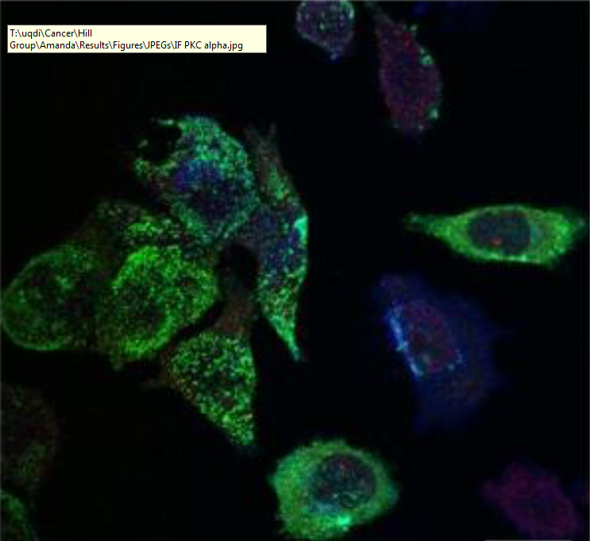
Selective Export of miRNAs in Prostate Cancer
Harley Robinson
Supervisor: Michelle Hill
Co-supervisor: Alex Cristino

Slide 2
Prostate cancer
Second highest diagnosed cancer in males worldwide.
1/3 of prostate cancer patients die
Advanced prostate cancer yields metastasis to bone and lymph.
Caveolin/cavin system implemented in advanced prostate cancer and exosome cargo sorting.

Slide 3
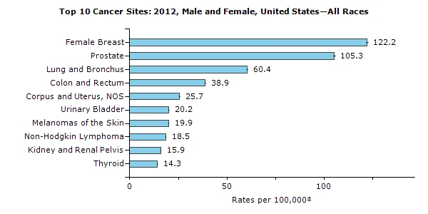
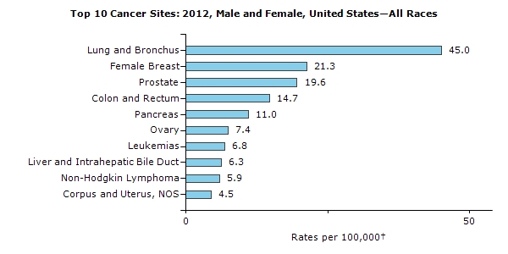

Slide 4
Exosomes in Cancer.
Sequester RNAs, proteins and lipids.
Some reabsorption of exosomes can be targeted to particular cell types.
In prostate cancer, homing proteins had been found.
Exosomes implemented in establishing pre-metastatic niche.

Slide 5
Caveolae, Caveolins and Cavins.
Introduce this system

Slide 6
Caveolins

Slide 7
Cavins

Slide 8
Cavins mediating the exosomal export

Slide 9
microRNAs in cancer. ?? Maybe or include this info on the last slide,

Slide 10
Hypothesis
Cavin-1 mediates selective export of miRNA species into exosomes.
Chaperones and escort proteins are mediated by Cavin-1

Slide 11
Aims
State the three aims.

Slide 12
Slide on PC3 cells

Slide 13
Methods- Aim1.
RNA-seq data> bioinformatics analysis.
RT-qPCR validation.

Slide 14
Explain the comparasions that will be made.

Slide 15
Method – Aim 2.
Identify targets through bioinformatics.
Verify targets through subcellular proteomics.
Finds potential interaction partners.

Slide 16
Expected or logic behind the aim?

Slide 17
Methods- aim 3
Functional assessment of potential interaction partners/ ECSRT protein.
Indirect Immunofluroescence, miRNA in-situ hybridization.

Slide 18
CoIP method

Slide 19
Significance
Mostly discuss what the results will do for future.

Slide 20
Acknowledgements

